Slide 1


Estate Planning
Date: September 19, 2024
Facilitator: Shari Carlson

Slide 2
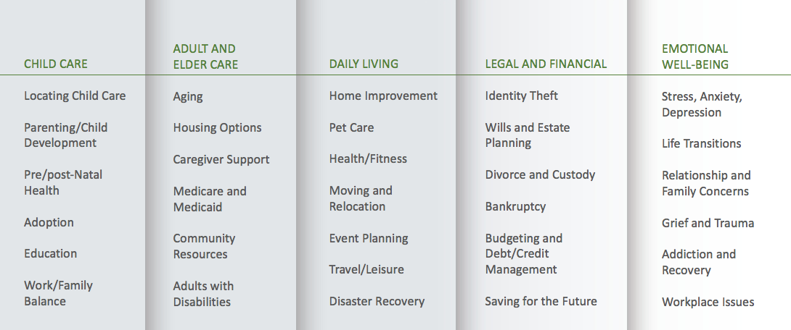
CCA@YourService:
How We Support Employees & Family Members
Notes:
Review the WLP & Services briefly

Slide 3

Features of CCA@YourService
  Confidential
  No Cost
  Employees & Family Members
  24/7
  800-833-8707
  www.myccaonline.com
  Company Code: CUNY
Notes:
Review the WLP & Services briefly

Slide 4
Seminar Objectives
Introduce types of estate planning documents
Review advance directives
Learn about the various estate planning terms
Discuss the pros and cons of various options
Consider the costs of estate planning

Slide 5

Estate Planning Documentation
Advance directives
Beneficiary forms
Wills
Guardianships
Conservatorships
Trust documents

Slide 6
What Are Advance Directives?
A written statement of your wishes, preferences and choices regarding end-of-life health care decisions
A tool to help you think through and communicate your choices
Only used if you are unable to express your preferences
Give your loved ones the gift of peace of mind
Notes:
This can happen to anyone – at any age

Slide 7
Types of Advance Directives: Durable Power of Attorney
Durable Power of Attorney
This is the person you designate to handle any financial questions that the hospital or medical center may have when you cannot speak for yourself
They should be consulted before you appoint them
They should have a copy of the document
Notes:
A Durable Power of Attorney is a legal form that states who you want to make decisions about your medical care.
The person is authorized to speak for you only if you are unable to make your own medical decisions

Slide 8
Types of Advance Directives: Health Care Proxy
Health Care Proxy
Why do we need a health care proxy?
When do we use a health care proxy?
Who should you choose as your health care proxy?
You should ask the individual BEFORE you appoint them
They should be in possession of a copy of your “living will”

Slide 9

Types of Advance Directives: Living Wills & Considerations
Living Wills & Considerations
What is a living will?
Why do we need a living will?
When is a living will used?
Notes:
A Living Will is a legal document which speaks for you when you are unable to do so. It defines the type of care that you wish to receive and do not wish to receive. This document also helps your Medical Proxy regarding your wishes when a question arises that is not addressed by it.
Only used: If you are seriously ill or injured, and unable to speak for yourself
Should Include: Living will, Medical (health care proxy), power of attorney

Slide 10
Types of Advance Directives: Hospital DNR
Hospital DNR
DNR = Do Not Resuscitate (A type of advance directive)
A request not to have cardiopulmonary resuscitation (CPR) if your heart stops or if you stop breathing
DNR orders are accepted by doctors and hospitals in
all states
Notes:
Unless given other instructions, hospital staff will try to help all patients whose heart has stopped or who have stopped breathing. Have on file at hospital and note from doctors that they know it is on file. You can use an advance directive form or tell your doctor that you don't want to be resuscitated

Slide 11
Tips for Preparing Advance Directives
Forms can be found at your state Attorney General’s office, doctors’ offices, state health departments or departments on aging
Seek support from a lawyer, although it does not need to be a legal form
You can write your wishes down by yourself: computer software package for legal documents
Documents can be changed any time
Notes:
Assist older relatives in preparing advance directives

Slide 12
Estate Planning Terms
Beneficiary
Joint Ownership
Probate
Testate
Intestate
Will
Estate
Executor
Heir
Guardianship
Conservatorship
Trust
Trustee

Slide 13
Beneficiary
The beneficiary is the person(s) or legal entity that receives assets upon the death of the owner
A beneficiary form instructs the financial institution who will receive your assets or benefits in the case of your death
Assets controlled by beneficiary forms include: insurance, 401K, IRA’s, annuities
Notes:
These assets pass outside of the Estate
Make sure you update all forms:
Change in marital status
Birth of children
Death of beneficiaries

Slide 14
Joint Ownership
Assets, when jointly owned, have survivorship rights
All states have some version of joint ownership with survivorship, regarding real property
Joint ownership of bank accounts and investment accounts have survivorship rights also
Notes:
“Survivorship” means that the property, real or personal, does not need to go through the probate process and are not part of an Estate

Slide 15
Probate
Probate is the legal process of transferring the Estate property (real and personal) from the name of the decedent to the heirs
This process is court supervised
Must settle all debts and claims before distributing property
Probate is required if the decedent passes testate (with a will) or intestate (without a will)

Slide 16

Wills
Who will get your assets when you die? (Does NOT supersede beneficiary forms)
If you do not have a will (intestate), who will decide how your assets are distributed, and will it be to your liking?
What happens when an estate goes through probate?
Tax implications

Slide 17
What Is a Will Substitute?
Pay On Death – POD
Transfer On Death – TOD
Joint accounts, adult children, powers of attorney
Beneficiary trust deeds
Considerations and how they differ from wills or trusts
Tax-deferred accounts: IRA, 401K, 403B, pensions

Slide 18

Executor
Executor is the party recognized by the probate court to supervise the settlement of the estate
Collect and inventory decedents properties or assets, including determining fair market values
Resolve any issues with creditors and pay administrative expenses
Prepare and file tax returns

Slide 19
Guardianship and Conservatorship
Guardianship
Families with minor children, dependent seniors or adults with special needs will appoint caretakers for dependents
In the absence of these instructions, the court will appoint a guardian
Conservatorship
A conservatorship is the creation of a trust or other financial document or account to pay for the needs of the individual for whom the guardianship is created

Slide 20
Trust Options
All trusts are governed by state law and keep affairs private.
Revocable Trust
Grantor and trustee are the same person and can provide for successor trustee under certain circumstances
Irrevocable Trust
Assets deposited into trust are not part of the estate
Testamentary Trust
Used by married couples, partners or significant others to delay probate until the death of the last person
Notes:
Revocable Trust
Can be “undone”
Does not avoid taxes
Irrevocable Trust
Cannot be “undone without court order”
Is used in many cases to avoid taxes
Testamentary Trust
Found within the wills of each of the individuals
Gives the surviving member a chance to take additional steps if necessary to avoid taxes

Slide 21
Various Options
Pros
Basic Will:
Simple, low-cost
Trust:
Can be customized
Provides protection from collections, in some cases
Cons
Basic Will:
May not be sufficient if you have children
Trust:
May be expensive
Can limit your options in the future

Slide 22
Cost
How much will it cost?
  Basic Will
  Health Care Proxy
  Power of Attorney
  Complex Estate Planning
May vary depending on where you live

Slide 23

Documentation Safekeeping
Lawyer
Spouse or partner
Safe deposit box
Trusted third person

Slide 24
Resources
www.aha.org
www.aafp.org
www.familydoctor.org
www.aarp.org
www.agingwithdignity.org
Notes:
Aha = American Hospital Association: search: “put it in writing” for info on advance directives
AAFP = The American Academy of Family Physicians
agingwithdignity.org produces 'The Five Wishes‘ document

Slide 25
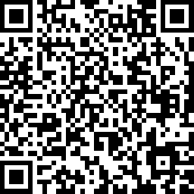
Webinar Evaluation Survey
Scan the QR code to fill out the evaluation survey!
THANK YOU!
Notes:
https://www.surveymonkey.com/r/ZNCBQL3

Slide 26

Thank you!
TOLL-FREE:
800-833-8707
WEBSITE:
www.myccaonline.com

