Slide 1

Advance Directives
March 25, 2026
Presenter: Greg Berlin

Slide 2

Features of BeWell by CCA
  Confidential
  No Cost
  Employees & Family Members
  24/7
  800-833-8707
  ccaplatform.com/go/cuny

Slide 3
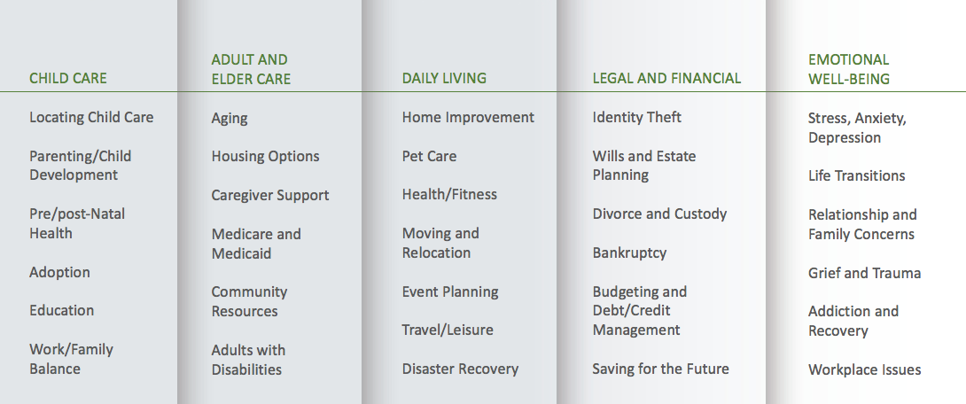
BeWell by CCA:
How We Support Employees & Family Members

Slide 4

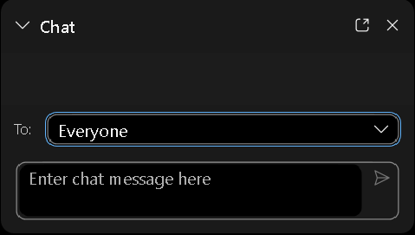
Housekeeping Tips for a Successful Session
WebEx controls appear at the bottom of the screen
Phone lines are muted, cameras are disabled
Please DO NOT put your phone on hold
Questions or comments for the presenter? Use chat and select “All Panelists”
Questions or comments for the group? Use chat and select “Everyone”
Reaction
Leave
Raise Hand
More Options:
Switch Audio
Copy Webinar Link
Switch to Mobile
Notes:
Review the housekeeping tips briefly (for Webex sessions)

Slide 5

Objectives
Define advance directives and identify the benefits
Learn about a living will and durable power of attorney for health care
Learn tips for preparing an advance directive
Identify strategies for communicating with older relatives about the need for advance directives
Identify resources that can help you complete your advance directives
Notes:
Over the next 60 minutes, I’ll familiarize you with advance directives …….
What are they and why you should care
We’ll look at 2 key directives including preparation tips and techniques
Highlight some strategies to have an effective conversation with your older relatives
And finally I’ll leave you with some important resources………
Let’s get started……..

Slide 6

What Is an Advance Directive?
A written statement of your wishes, preferences, and choices regarding end-of-life health care decisions
A tool to help you think through and communicate your choices
Written instructions about future medical care
Notes:
This slide covers the what advance directives are
There are significant benefits to an advance directive that let’s you clearly think through the health care treatments you would or would not want if you couldn’t speak for yourself……..in a balanced, non-emergency atmosphere.......
Your wishes will be known
Only used if you are unable to express your decisions
This can happen to anyone – at any age
Give your loved ones the gift of peace of mind – write down your wishes!

Slide 7

Why Do We Need
Advance Directives?
Your wishes will be known
Only used if you are unable to express your decisions
This can happen to anyone – at any age
Give your loved ones the gift of peace of mind – write down your wishes!
Notes:
This slide explains the clear advantages to the advance directives……..
And begin with yourself? Do you have an advance directive?
Let’s take a look at some guiding principles to consider……….

Slide 8


Considerations
Only used:
If you are seriously ill or injured, and
Unable to speak for yourself
Should include:
Living will
Medical (health care proxy) power of attorney
Notes:
This slide explains the clear advantages to the advance directives……..
And begin with yourself? Do you have an advance directive?
Let’s take a look at some guiding principles to consider……….

Slide 9

Living Wills
What is a living will?
Why do we need a living will?
When is a living will used?
Notes:
A Living Will is a legal document which expresses your wishes with respect to life prolonging medical treatment
A living will is a good thing to have if you feel strongly about how your life would or would not be sustained should you become incapacitated – it can also take the burden off family members who may not agree on what course of action to take and can in some cases end up in court.
A living will is only used when you become incapacitated.
Provide examples/scenarios for the “why” and “when”
Continue to emphasize the value of creating these documents before a crisis occurs.

Slide 10

Durable Power of Attorney
What is a "Durable Power of Attorney" for health care, or "Health Care Proxy"?
May also be called:
“Health Care Proxy or Agent"
“Health Care Surrogate”
“Medical Power of Attorney for Health Care"
Notes:
A Durable Power of Attorney is a legal form that states who you want to make decisions about your medical care.
The person is authorized to speak for you only if you are unable to make your own medical decisions
A health care proxy is not a living will. A living will is not a health care proxy. They are two very different legal documents. A living will allows you to leave written instructions that explain your health care wishes, especially about end-of-life care. A living will is a written statement of your wishes. A health care proxy empowers another person to speak for you. A living will has no place for you to express your choice of medical treatments.

Slide 11

Health Care Proxy
Why do we need a health care proxy?
When do we use a health care proxy?
Who should you choose as your health care proxy?
Should I have both a living will and a durable power of attorney?
Notes:
A health care proxy speaks for you if you can’t speak for yourself. A health care proxy is a legal paper that lets you pick another person to make health care decisions for you, if and only if you are unable to communicate.
It is used when you cannot speak for yourself most often due to a temporary or sudden disability.
You should choose someone whom you can trust and who shares the same beliefs as you when making these kinds of decisions.
A health care proxy is not a living will. A living will is not a health care proxy. They are two very different legal documents. A living will allows you to leave written instructions that explain your health care wishes, especially about end-of-life care. A living will is a written statement of your wishes. A health care proxy empowers another person to speak for you. A living will has no place for you to express your choice of medical treatments.

Slide 12

Advance Directives Advantages
You are in charge of making your own decisions
Documents can be changed anytime
You do not need an attorney
Documents can help you express your wishes
Individual forms are available to download at your state government website
Notes:
To reiterate the importance…….create a scenario that depicts what happens if there is an emergency with no “ad’s” in place.

Slide 13

Hospital DNR
DNR = Do Not Resuscitate
Another kind of advance directive
A request not to have cardiopulmonary resuscitation (CPR) if your heart stops or if you stop breathing
You can use an advance directive form or tell your doctor that you don't want to be resuscitated
DNR orders are accepted by doctors and hospitals in all states
Notes:
Unless given other instructions, hospital staff will try to help all patients whose heart has stopped or who have stopped breathing.

Slide 14
Five Wishes
A national advance directive written in simple language that helps start important conversations about care
It combines the living will and health-care power of attorney documents, and addresses matters of comfort care, spirituality, forgiveness, and final wishes
Created by the nonprofit organization Aging with Dignity
Notes:
The Five Wishes:
Comfort
Care
Spirituality
Forgiveness
Final wishes

Slide 15
Tips
Tips for preparing an advance directive:
Some doctor’s offices can provide a form
You can write your wishes down by yourself
State health department or department on aging have forms
Lawyer – although it does not need to be a legal form
Computer software package for legal documents
Assisting Older Relatives in Preparing Advance Directives
Notes:
Suggestion: Easy access to documents once created - - upon hospital admittance one of the first questions asked is do you have “ad’s” and the hospital will need copies of the documents for the file.

Slide 16
Resources
putitinwriting.org
aafp.org
familydoctor.org
aarp.org
care.com
Notes:
Suggestion: Easy access to documents once created - - upon hospital admittance one of the first questions asked is do you have “ad’s” and the hospital will need copies of the documents for the file.

Slide 17
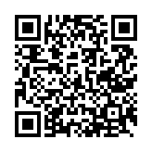
Seminar Evaluation Survey
Please scan the QR code to fill out the evaluation survey.
Thank you!

Slide 18
Thank you!

