Slide 1

FY 2026 Q3 Financial Report Update
May 12, 2026

Slide 2
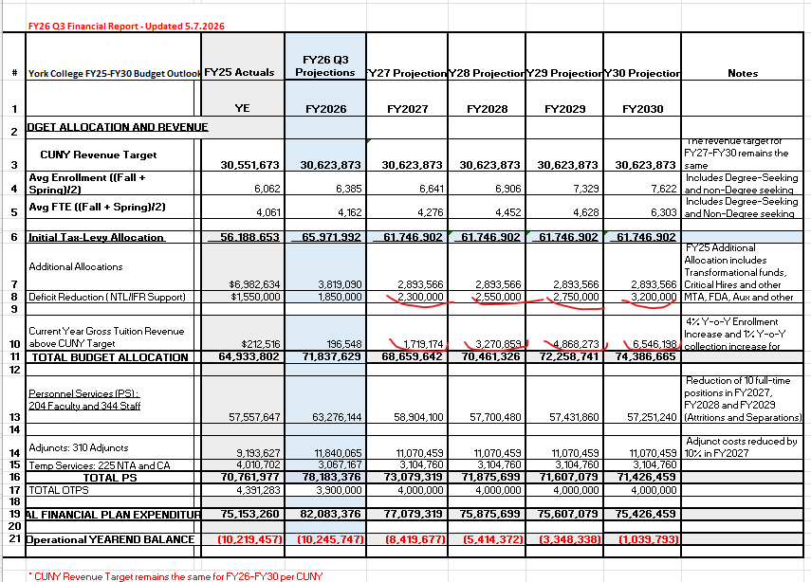
FY 2026 Q3 and Financial Plan Update

Slide 3
PS Projections For FY27-FY30
PS for FY26 includes the PSC bonuses and retro payments,
which will not carry over into FY27.
As a result, the FY27 projected PS regular expense is $4.3M lower than FY26.
The decrease is primarily driven by:
  $5.2M in PSC bonuses and retro payments not carrying over into FY27
  Projected new hire and termination savings in FY27

Slide 4
FY 2026 Q3 and Financial Plan Update
FY 2027 –FY 2030 FP: Key Assumptions
    Projected Revenue
    4% annual revenue growth through FY2030
    1% annual increase ($323K) in collections from FY2027 through FY2030 (details on page 4)
    Increased NTL support for the tax levy (details on page 5)
    Expenditures
    Hiring freeze remains in effect
    Reduction of 10 full-time positions in FY2027, FY2028 and FY2029
    (Attritions and Separations)
    Adjunct costs are projected to decrease by 10% in FY2027 and remain flat thereafter, in alignment with the Academic Cost Optimization Plan, with potential adjustments based on projected enrollment trends.

Slide 5
NTL support for TL budget

Slide 6
FY 2026 Q3 and Financial Plan Update
Fourth Round Cash Deficit Meeting with CUNY – May 15, 2026
Based on the projected FY26 deficit:
    Anticipated implementation of a full hiring freeze
    Exceptions limited to Health and Safety positions
  Expected impact:
    Reduction in personal services (PS) expenses
    Increased accrual savings to help meet budget targets
  Next steps:
    College to discuss and develop additional ALL Funds saving strategies for achieving balanced budget in FY2030

